Slide 1

Intro to Computer Science
DEMI G4S1-Lesson 3–Sprites in Action (Events).
الجلسة التطبيقية: الثالثة
المستوى: الثاني

Slide 2
Advanced Python Programming
DEMI G5S3-Lesson 1 – Class Monitor

Slide 3
Introduce yourself
Tell us your name, age/grade, and your hobbies
Spin the wheel
Open the random wheel
Answer the random question on the screen
Notes:
https://wheelofnames.com/eqj-8zc

Slide 5
1
Learn
Learn about how to use programming and AI to make our life better.
Learn about AI applications and how it can be used in the education field.
Learn about generating and developing new ideas.
Learn how to use AI extensions and facial recognition technology
Make
Class Monitor
Debug your code and test it
Share
Present the project we have done today

Slide 6
Do you remember what is meant by Artificial intelligence (AI)?

Slide 7

AI systems are designed to perform tasks that would normally require human intelligence, such as recognizing speech, facial recognition, making decisions, and translating languages.

Slide 8
Could you mention any examples for AI in our lives?

Slide 9

AI is becoming increasingly integrated into our daily lives across various domains.

Slide 10

Smart home devices

Slide 11
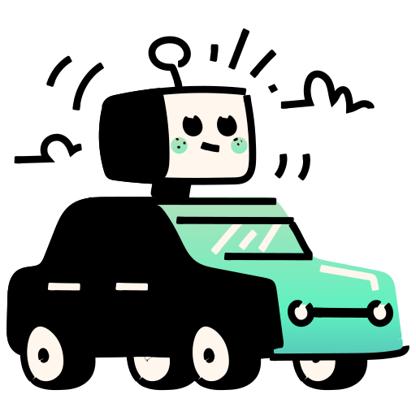
Self-driving cars

Slide 12
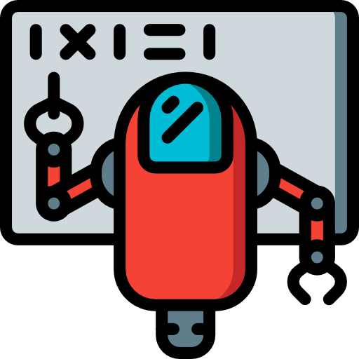
personalized learning platforms for education, and Translation Services

Slide 13
How could use artificial intelligence (AI) to make education better?

Slide 14


Let’s imagine you are a teacher, you need to take attendance to make sure everyone is present. This means you have to call out each student's name, wait for them to respond, and then mark them present or absent.
Now imagine you have a simple computer program, like a tablet at the classroom entrance. When students enter the classroom, they tap their name on the tablet to check in.The tablet automatically records who is present.

Slide 15
What is Facial Recognition Technology?

Slide 16
Facial recognition technology analyzes the uniqueness of a person’s face to identify or verify their identity.
It could be used for a wide variety of application like unlocking mobile phones for security or could be used an attendance system.

Slide 17
So how can we do that?

Slide 18
Using a teachable machine we could train a model to identify a person’s face by subjecting it to a lot of samples of this person.

Slide 19
What are some other ways programming and AI can be used to help your school?

Slide 20
Tech-Innovators Challenge

Slide 21

Tech-Innovators Challenge
Divide the class into two teams: Team Teachers and Team Students.
Each team gets 15 minutes to brainstorm and list out repetitive tasks they encounter in the classroom from their respective perspectives.
Team Teachers think about tasks that teachers often repeat, such as grading assignments, taking attendance, managing class schedules.
Team Students consider tasks that students find repetitive or cumbersome, like submitting homework, checking grades, finding study materials.
Each team selects one or two tasks from their list that they believe programming could simplify and present it to the class.

Slide 22

15 دقائق

Slide 24
Class Monitor:
Design and implement an attendance system to track the attendance in your school

Slide 25
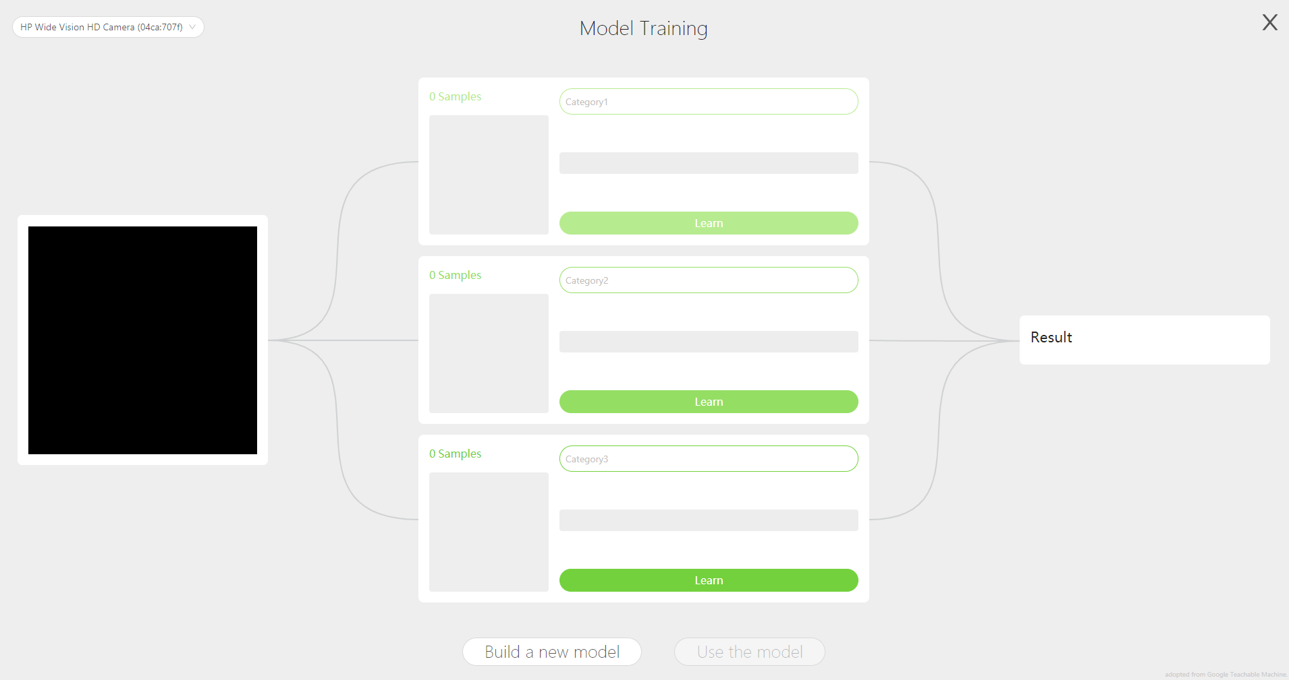
1/2
Use Teachable Machine Extension to train model that recognize students based on their images.

Slide 26
2/2
Use variables to store the students recognized by the Teachable Machine model.
Use lists to store all students in the class and organize attendance records. For example, one list can store attendees and another list can store absentees.

Slide 28
Project
Projects
Class Monitor

Slide 30


